Slide 1
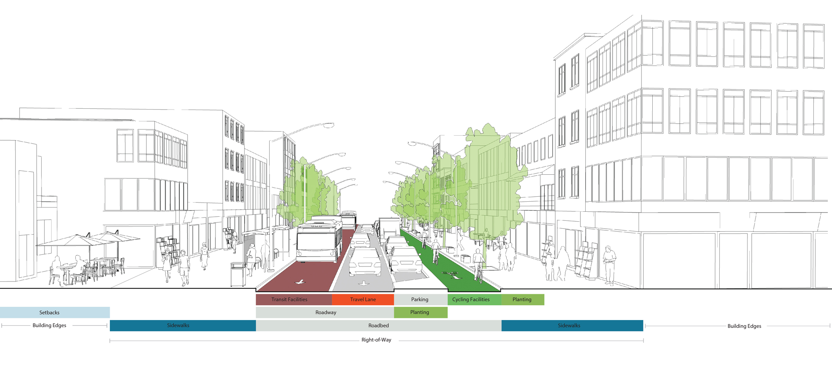
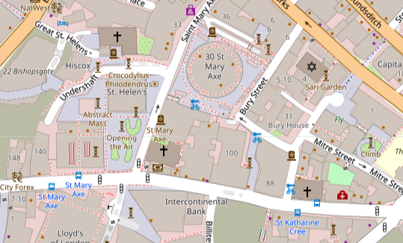
Function
Infrastructure
Mapping
Access
Movement
Public Realm
The spaces ‘between’ buildings.
Pavement Centre Lines: ‘Sidewalks’
Walking routes: ’Footways’
Global Designing Cities Initiative (2022)
OpenStreetMap(2022)

